Slide 1

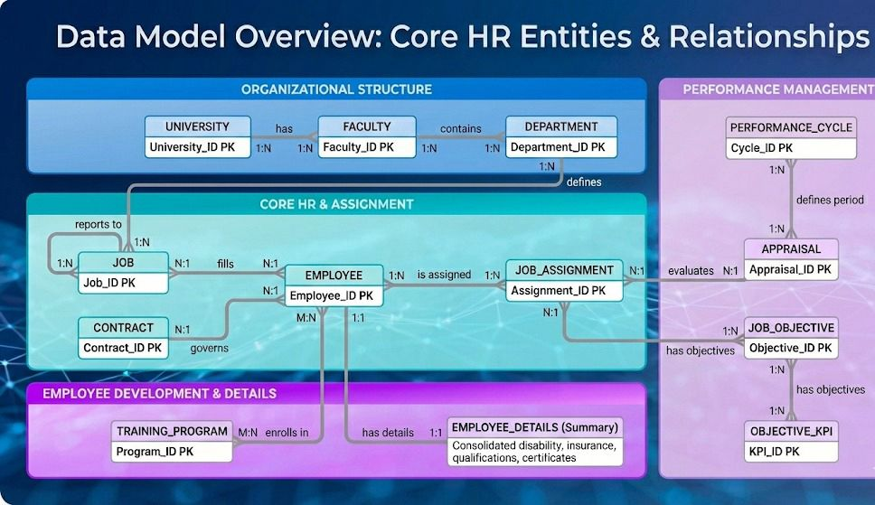
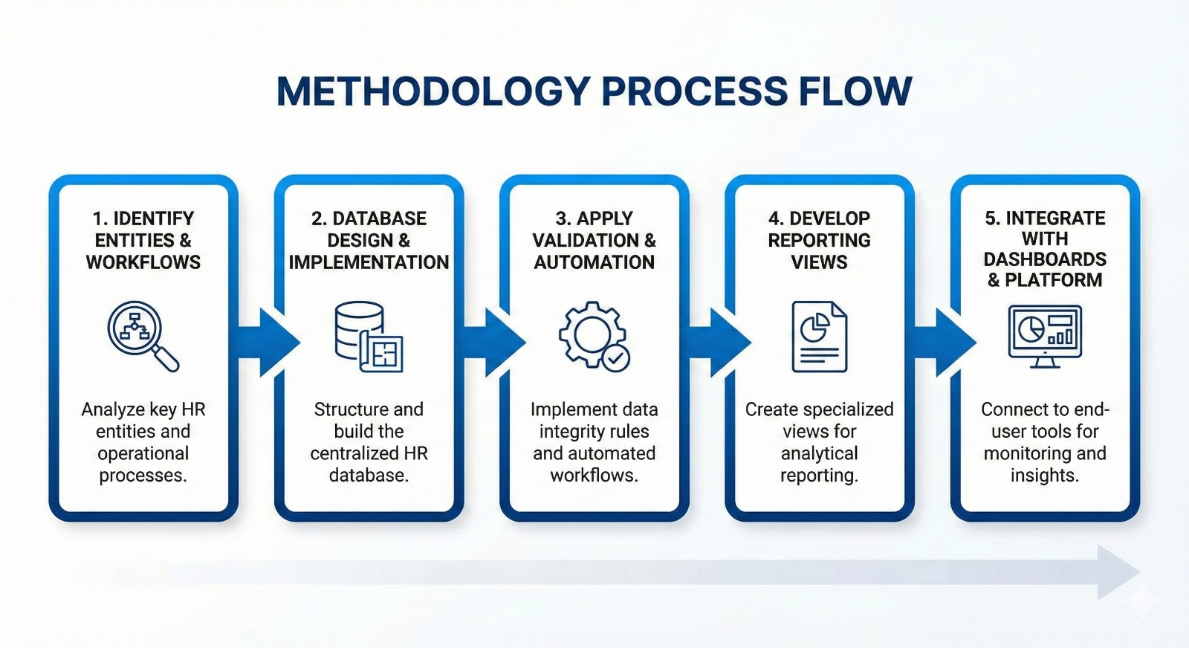

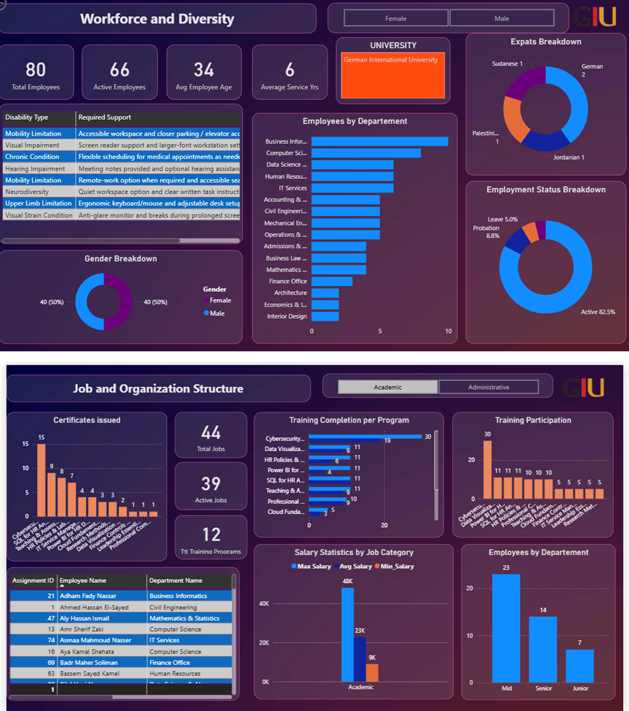
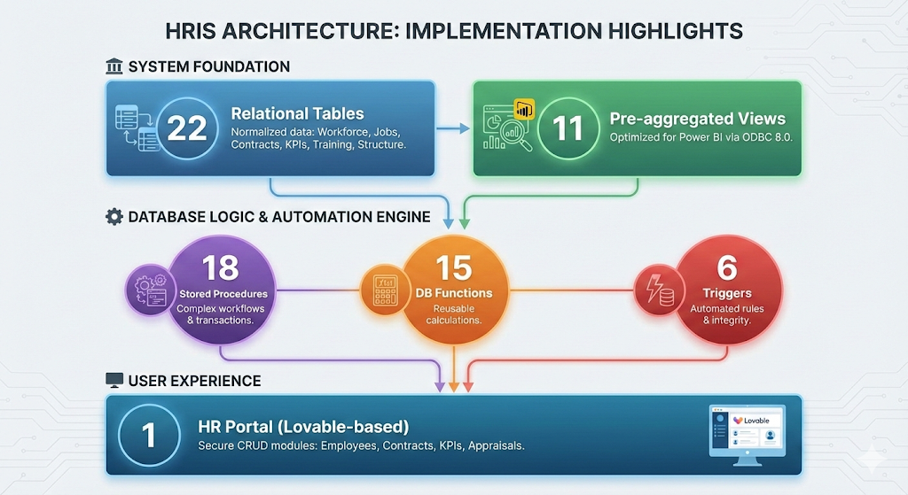
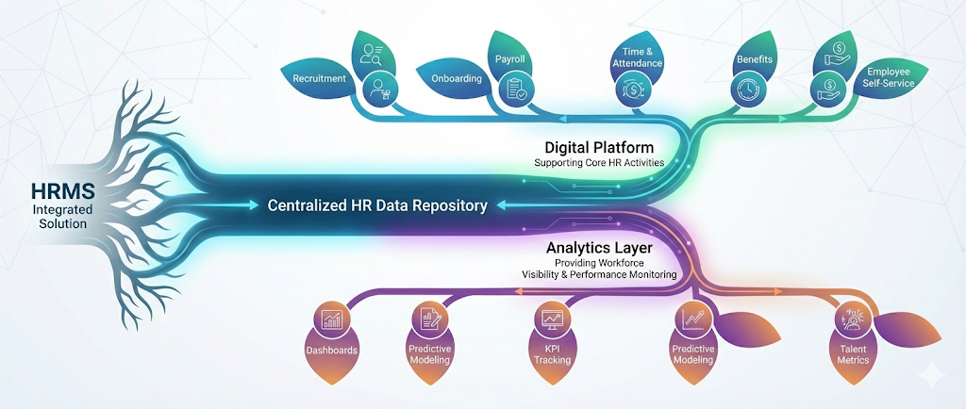
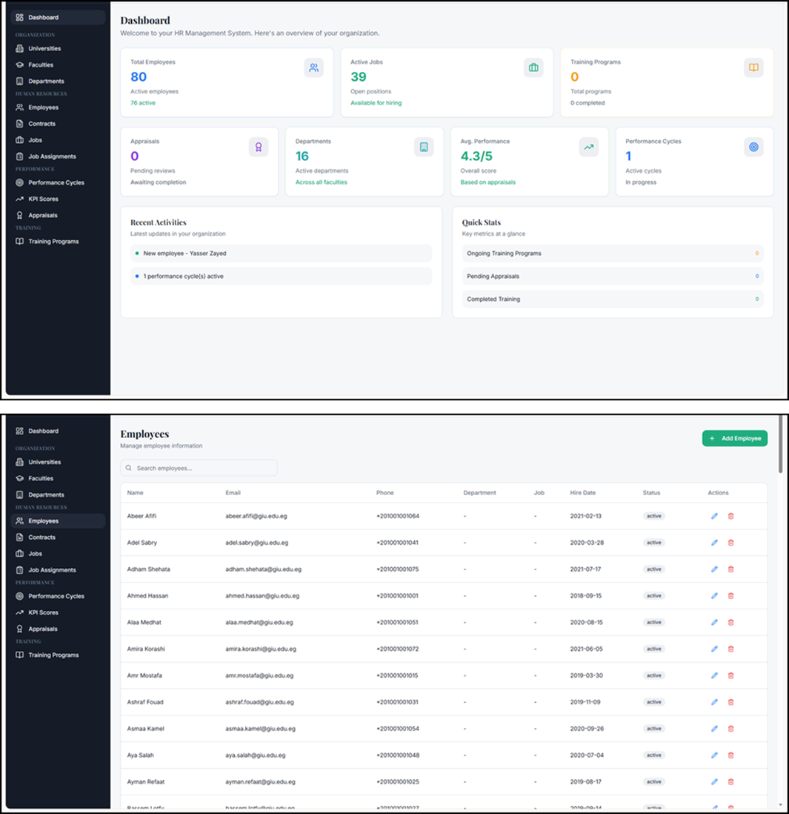
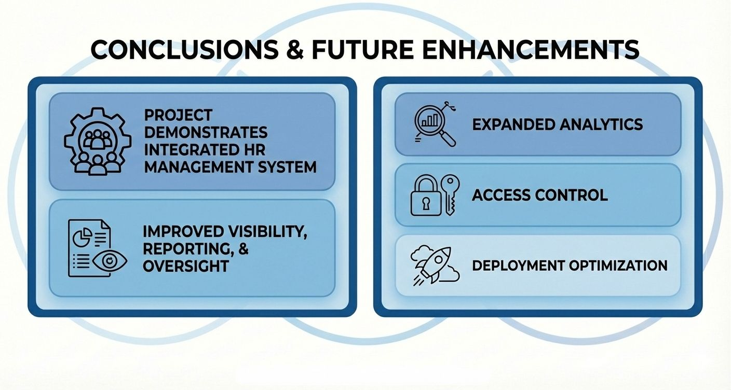
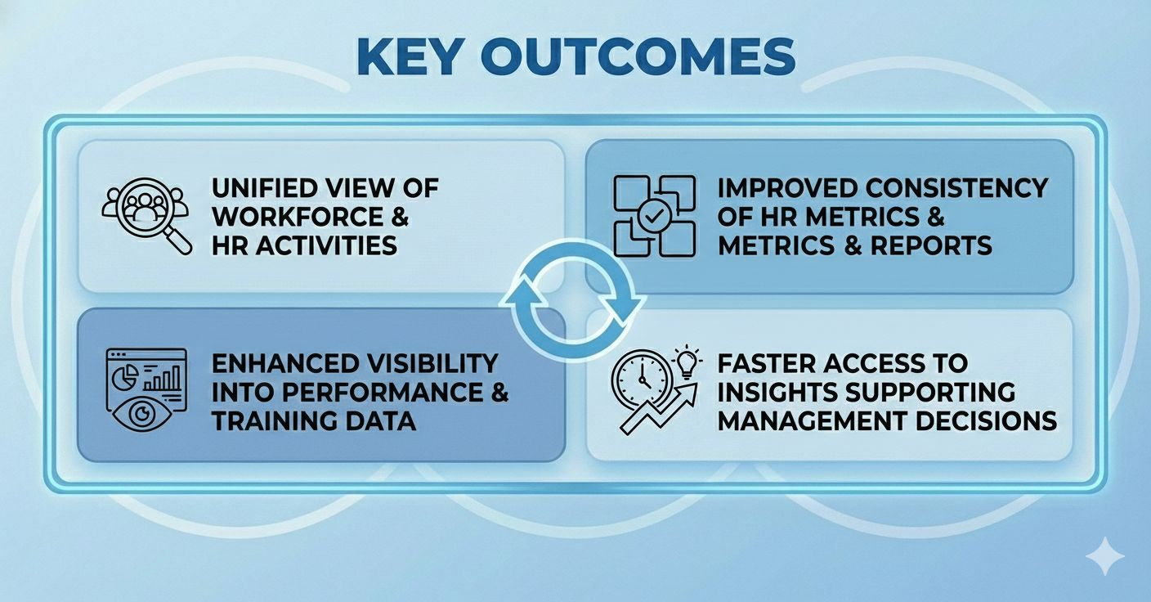

1st Student Poster Conference Emerging Trends in Economics, Business and Data Science
Faculty of Economics & Business Administration
HR Management & Analytics System
An Integrated Platform for HR Operations, Workforce Analytics, and Decision Support
Design and implement an integrated HR Management System that supports core HR operations and analytical reporting. The system centralizes workforce, contracts, job roles, performance KPIs, and training data within a MySQL database, and deliver insights through Power BI dashboards and a web application portal.
Database Design (ERD)
Methodology
Power BI Dashboards and Web Application
System Overview
Implementation Highlights
Web Application
Conclusions & Next Steps
Key Results / Outputs
Mohammed Waleed • Omar Ehab • Ali El Naggar •Kareem Tamer
Course: Databases
2026
Supervised By: [Dr Shaimaa Masry]
Poster
#
Scan for Live Demo

